Slide 1

Politecnico di Milano
A.A. 2015-2016
Software Engineering 2 project:
MyTaxiService
Alessandro Pozzi (matr. 852358),
Marco Romani (matr. 852361)

Slide 2
Overview of MyTaxiService project
The system have been designed from an HIGH-LEVEL point of view.
No constraints on the implementation (language or algorithms)
MyTaxiService is just an interface between customers and taxi drivers.
Payment and unexpected behaviour of customers have not been modelled.
No need for complex algorithm to model the taxi redistribution (high density area -> low density area)
Idea: keep what, in the real taxi service, already works.

Slide 3
Requirements

Slide 4
Domain Assumptions
A taxi driver account cannot be used as a customer account, and vice versa. This means that if a taxi driver wants to access the customer’s services, he will need to create a customer account.
Web and mobile registration are intended for customers only. Taxi drivers’ account are created by an administrator.
Taxi drivers’ status must be updated manually, except when the driver accept a ride request by a MTS customer.

Slide 5
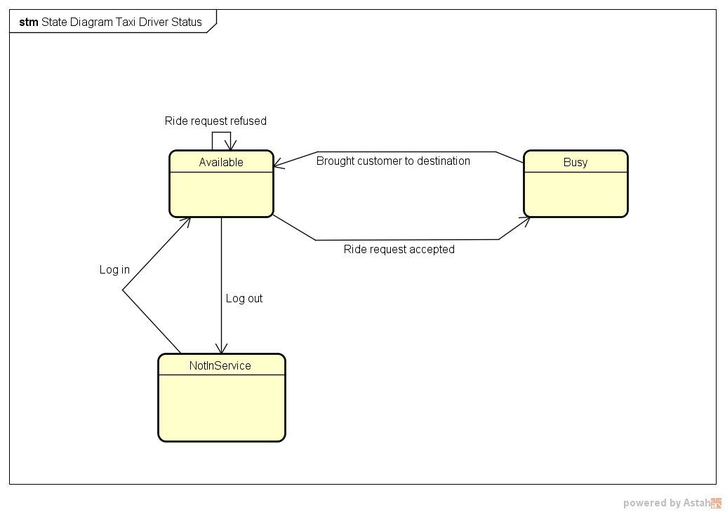
About the possible status of taxi drivers…
Where “ride request” may even come from standard customers or MTS reservations.

Slide 6
Domain Assumptions
Payment and specific duties related to the taxi service are not considered and managed by the application. MyTaxiService is meant to be only an interface between customers and taxi drivers.
The taxi service company is using a (possibly external) email service, which can provide email accounts to be given to taxi drivers and (eventually) other member of the company.
The taxi company has a call center that customer and taxi drivers can contact to report issues that cannot be resolved otherwise.

Slide 7
Domain Assumptions
If and only if a taxi zone there are no taxi available to answer a request, the system will search for an available taxi in adjoining zones. If there are no taxi available in the adjoined zones, the costumer will be notified and put in hold.
Unexpected behaviors of costumers that are habitually handled by taxi drivers won’t be handled automatically by MTS. Examples: inconsistent ride origin or destination, inexistent house number, etc.
Unlimited taxi reservations can be performed. However, impracticable reservations identified at runtime will be cancelled.

Slide 8
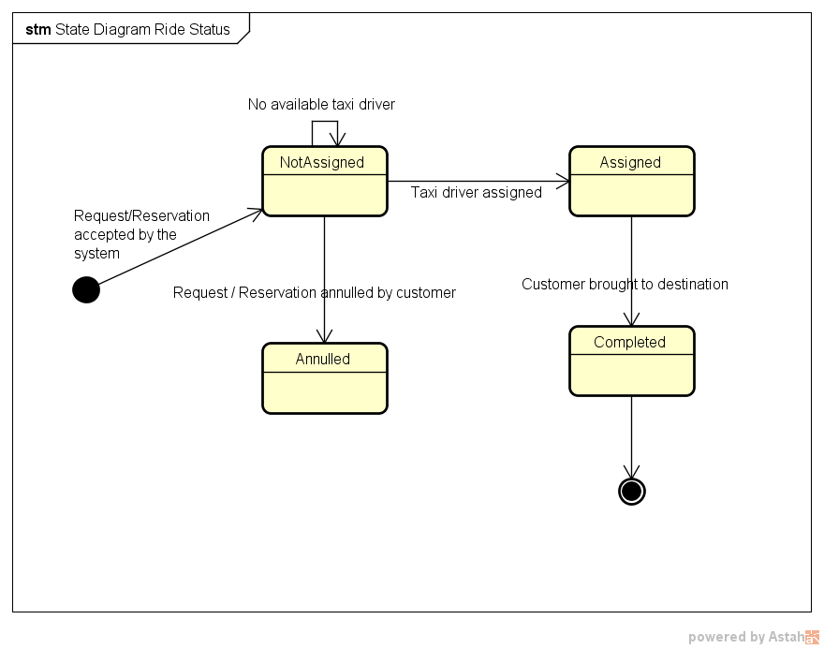
About the possible status of a ride…

Slide 9
Goals and functional requirements
[G1] Allow customers to access the system’s taxi service in any moment, whether they are at home or anywhere else in the city.
[R1] Customers should be able to access the service through both the web and the mobile application, even at the same time.
[R2] Customers must be able to register to the taxi service from the mobile or web homepage.
[R3] Only registered customers can access MTS’s services.
[R4] The system should allow the log out functionality.

Slide 10
Goals and functional requirements
[G2] Allow customers to request a taxi ride from an arranged location.
[R1] Only registered customers can request a taxi ride.
[R2] Customers must insert a valid origin location in order to request a ride.
[R3] The system will not allow more than a request if the previous one (either request or reservation) has not been accomplished yet.

Slide 11
Goals and functional requirements
[G3] Allow customers to reserve a taxi ride at a specific time with a given origin and destination.
[R1] The system should allow taxi reservations for a specific path communicated by the customer.
[R2] The system must not allow overlaps between reservations (or requests) made by the same customer.
[R3] The system allows reservations only 2 hours before the time and date specified by the customer.
[R4] The system will assign a taxi driver for the reserved ride 10 minutes before the time and date specified by the customer.

Slide 12
Goals and functional requirements
[G4] Allow taxi drivers to answer a ride request and take care of customers.
[R1] Taxi drivers should be able to communicate their current availability state to the system.
[R2] If available, taxi drivers should be able to receive incoming requests.
[R3] After receiving an incoming request, the taxi driver should be able to either confirm or not his intention to take charge of the request.
[R4] Taxi drivers must be able to log in the mobile application with preassigned credential and be identified as drivers.

Slide 13
Goals and functional requirements
[G6] Allow customers to be notified of any relevant update connected to their requests and reservations.
[R1] The system should send updates through email and/or in-app notification, as specified by the customer.
[R2] Absence of taxis available, reservations overlaps, taxi average waiting time and taxi assigned to customers are events that must be notified to the customer.

Slide 14
Goals and functional requirements
[G7] Customers and taxi drivers must be able to contact each other after the system has paired them.
[R1] Customers must leave a valid phone number in order to complete the registration phase.
[R2] Taxi drivers must be able to access to the customer’s phone number when the system has paired them.
[R3] Customers must receive the taxi drivers’ contact number after the system has paired them.
[R4] Customers must receive the taxi code in order to be able to recognize its driver.

Slide 15
Goals and functional requirements
[G8] Allow customers to delete requests and reservations.
[R1] Customers can delete a request or reservation only if it has not been assigned to a taxi driver yet.
[R2] Customers must be able to visualize the list of all their requests and reservations.

Slide 16
Goals and functional requirements
[G9] Administrators must be able to manage taxi drivers’ information and customers’ ride.
[R1] Administrators must be able to create a taxi driver’s account.
[R2] Administrators must be able to delete a taxi driver’s account.
[R3] Administrators must be able to change the status of taxi driver.
[R4] Administrators must be able to change the status of a ride.

Slide 17
Goals and functional requirements
[G10] Customers and taxi driver must be able to report issues and obtain assistance.
[R1] Customers and taxi drivers must be able to visualize, both in the mobile and web application, a support phone number which they can call to obtain assistance.

Slide 18
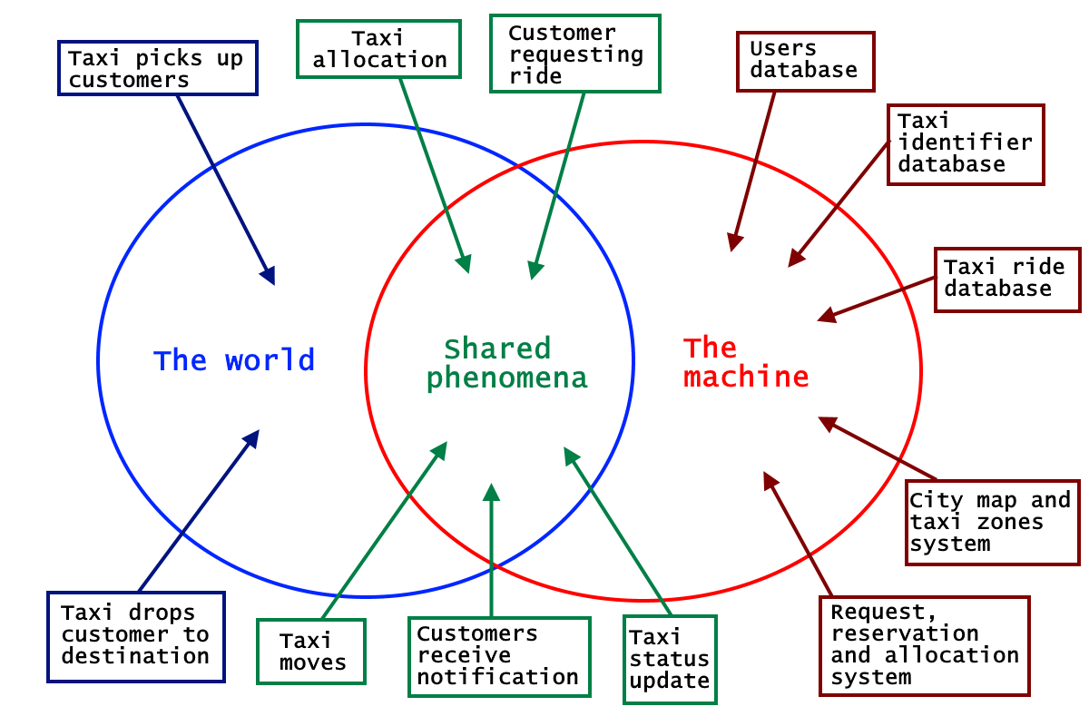
The world and the machine

Slide 19
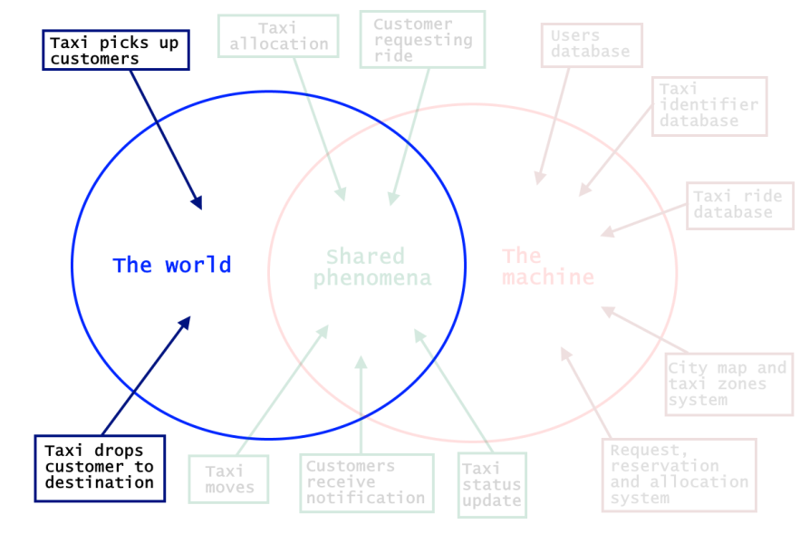
The world
Taxi picks up customers – happens exclusively in the world and it is not observed by the machine
Taxi drops customers to destination – it is not seen by the machine, which can only see the driver’s change of status

Slide 20
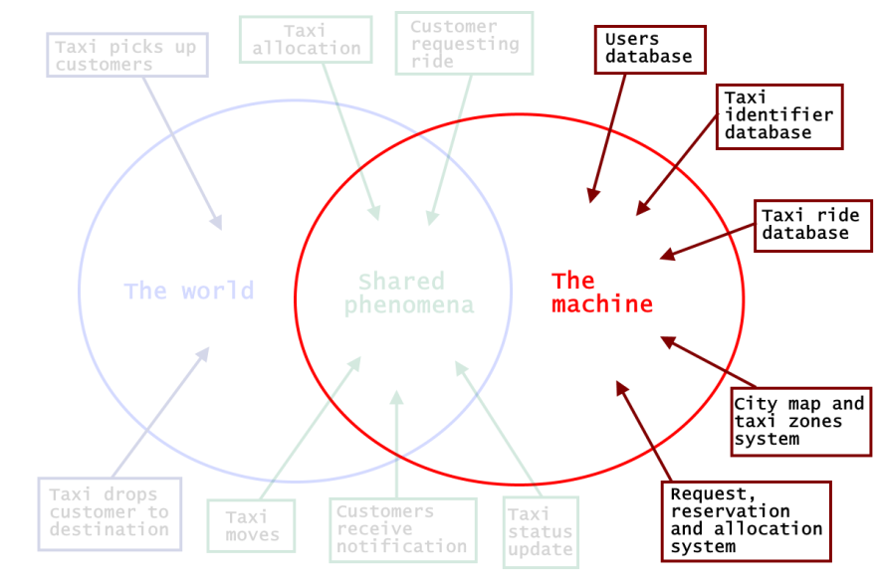
The machine
Users database – Contains all the users’ accounts: Admins, Taxi drivers and Customers
Taxi identifier database - contain all the information about taxis and their assigned drivers.
Taxi ride database - Store all the information regarding actual, past and future taxi rides
City map and taxi zones system – Contains and manages the taxi zones and the queues
Request, reservation and allocation system – manages the main application logic

Slide 21
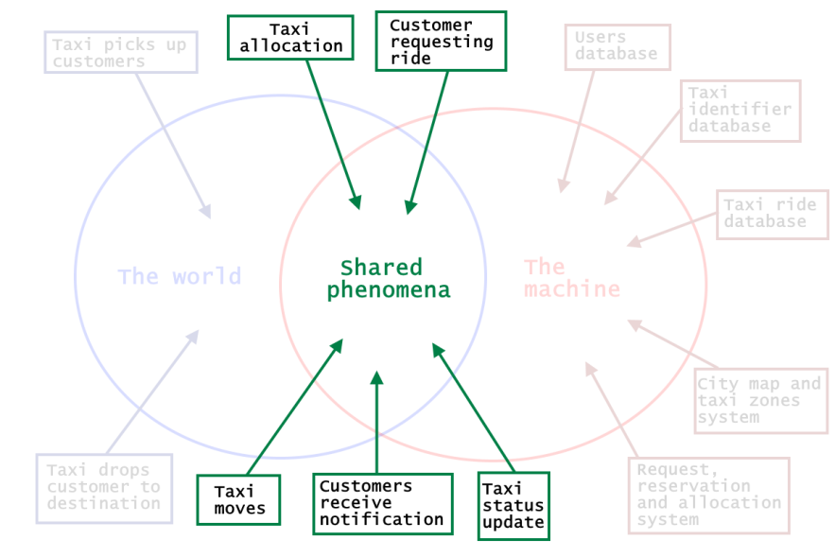
The Shared Phenomena
Taxi allocation - is a particular entity: for MTS customers it’s observed by the world and controlled by the machine; for standard customers it is observed by the machine (with the GPS and taxi zones system) and controlled by the world.
Customer requesting ride - happens in the world and is only observed by the machine, which will react accordingly.
Taxi moves - is a shared phenomenon, which is controlled by the world and observed by the machine through the GPS system.
Taxi status update - is also a phenomenon controlled by the world (i.e. the taxi driver that changes their status by picking up and dropping of customers) and observed by the system.
Customers receive notifications - is machine-controlled, since customers receive updates about their rides by the system.

Slide 22
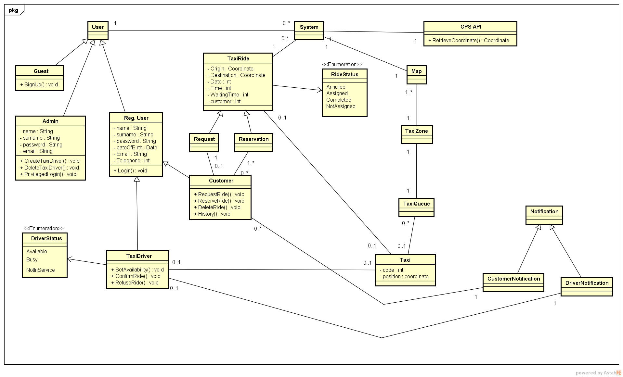
Class Diagram

Slide 24
Design

Slide 25
Problem overview
Different users communicating over the internet with a single system
Client-Server three-tier Architecture
Users can use different platforms (mobile and web)
The system accepts user’s requests and elaborate an answer in a short time
Event-based architecture with Publisher-Subscribe
The system must notify multiple users when some events occur

Slide 26
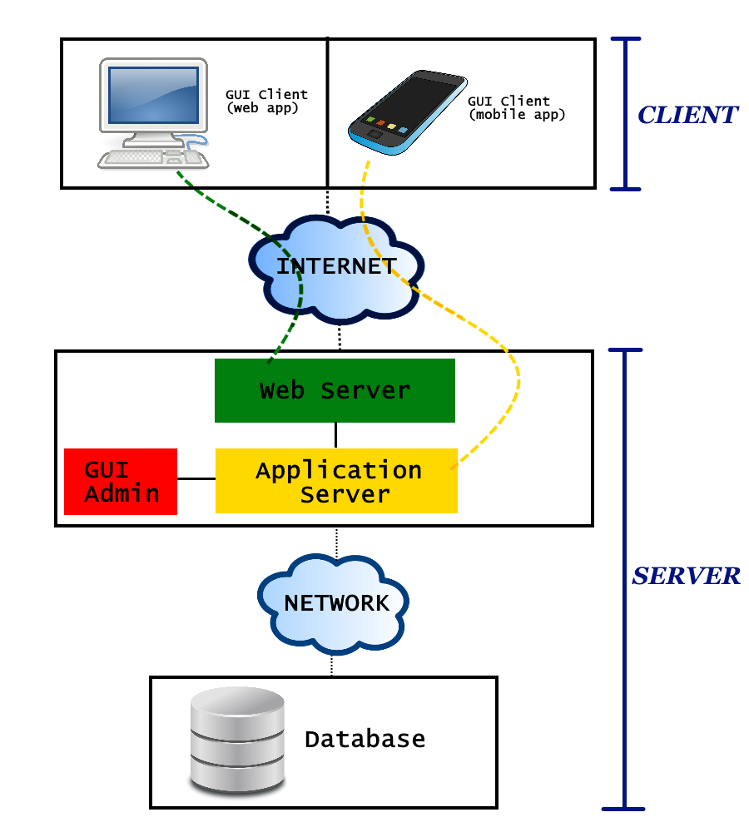
Three tier architecture
Top tier (Client)
The users’ machines (mobile phones and computers) will have the only purpose to load the Graphical User Interface (GUI)
No application logic is involved at this level
Clients will only be able to send requests to the web server and application server.

Slide 27
Three tier architecture
Middle tier
Web Server
Manages the web requests sent by clients using the web application.
If the request can be resolved with a static content page, the web server will generate and send the response itself.
If the request comports a dynamic content, the web server will delegate the dynamic response generation to the application server

Slide 28
Three tier architecture
Middle tier
Application Server
Contains the business logic
Provide lightweight APIs to be used directly by mobile application clients
Web application clients will access this component indirectly, through the Web Server.
Admin’s GUI
Specific interface for Administrators
Allows Admins to access to their exclusive functions dialoguing directly with the business logic

Slide 29
Three tier architecture
Bottom tier (Database)
Separated from the previous one with a (possibly local) network
Contains all the data that MyTaxiService needs to store

Slide 30
Event-based architecture
The core of MTS’s application logic is event-based:
Significant change of state (users modifying theirs account information, drivers changing status, etc)
Event
The system will handle it accordingly
Generates
In particular, the managing of the customer’s requests and taxi rides will be modeled with the publisher-subscribe pattern.

Slide 31
Publish-Subscribe pattern
CUSTOMER
TAXI RIDE
TAXI DRIVER
Asks for
Accepts the ride request and gets associated to the ride
The system generates
TOPIC
The customer is automatically subscribed to the topic and can receive its notifications
The driver is subscribed to the same topic too

Slide 32
Publish-Subscribe pattern
A logical component of the system that creates a publication on a topic when something relevant happens
Publisher
BROKER
An intermediary component that performs the queue management and the filtering of the messages
Filter messages based on their content, so that taxi drivers and customers related to the same topic won’t receive necessary the same notification or message
Subscribers
Messages are delivered to the subscribers (taxi drivers and customers)

Slide 33
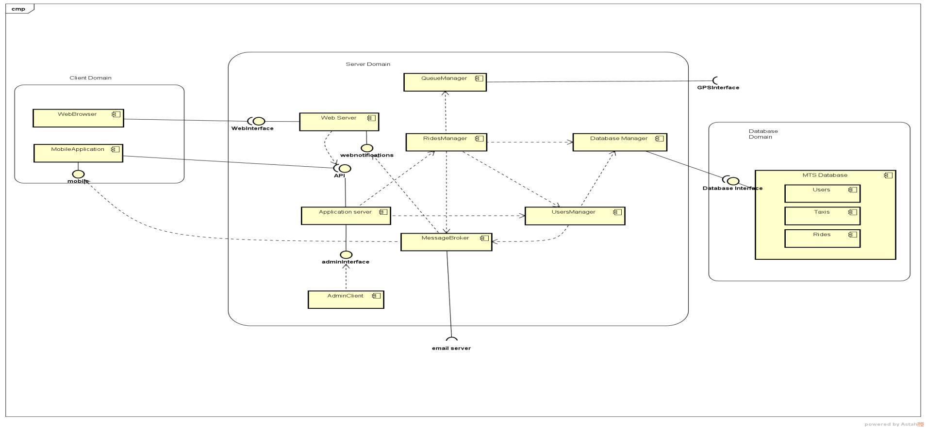
Components

Slide 34
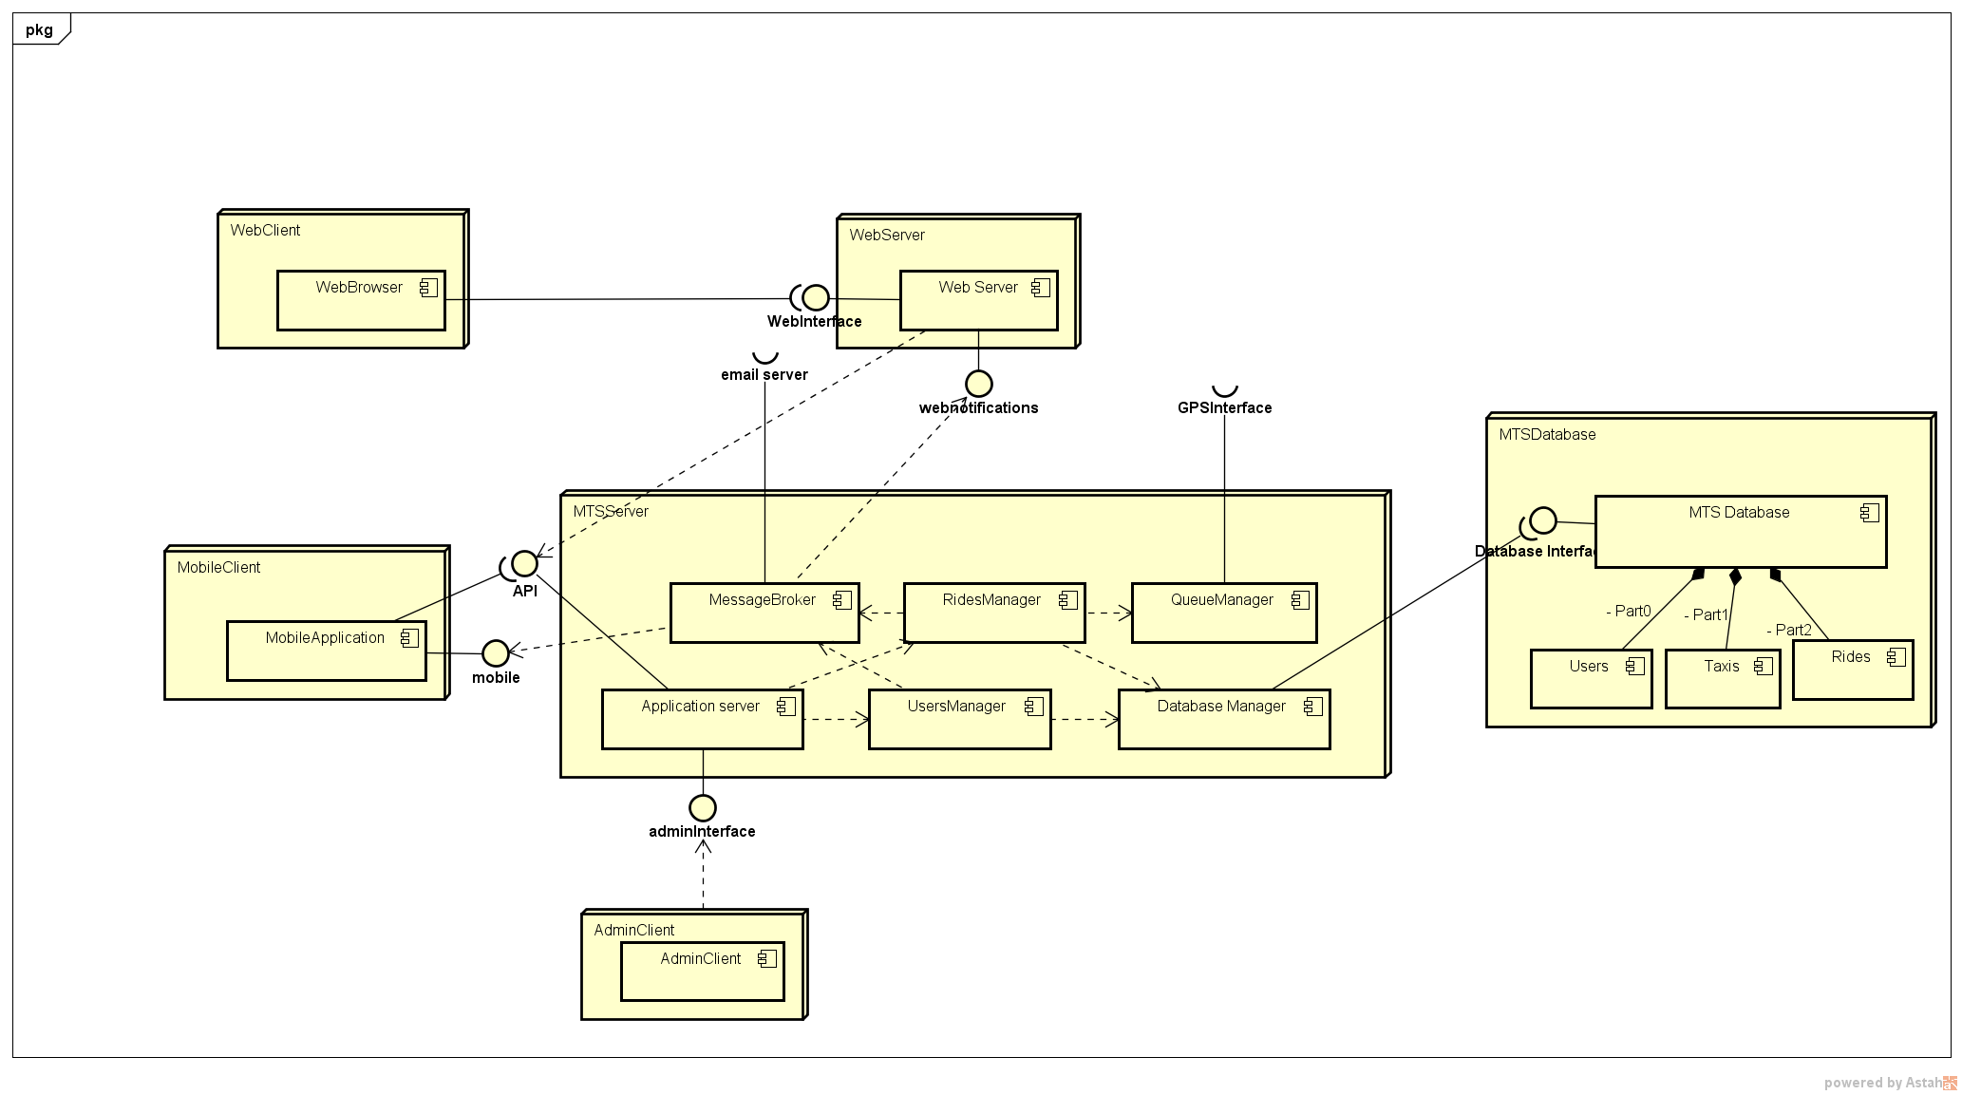
Deployment

Slide 35
Integration Test Plan

Slide 36
Integration Testing Plan
The components are divided in 3 subsystems:
Application Server
Web Server
Client
Each subsystem can be tested separately.

Slide 37
Integration Strategy
Application Server → Bottom-up strategy
Stubs will be used only for external component not to be tested (e.g. Client, Email Server, etc.)
Web Server and Client → No precise integration strategy is needed
They strongly rely on remote services and network communication
They deal with the Graphical User Interface
They can be tested without complex integrations (stubs and drivers provided)

Slide 38
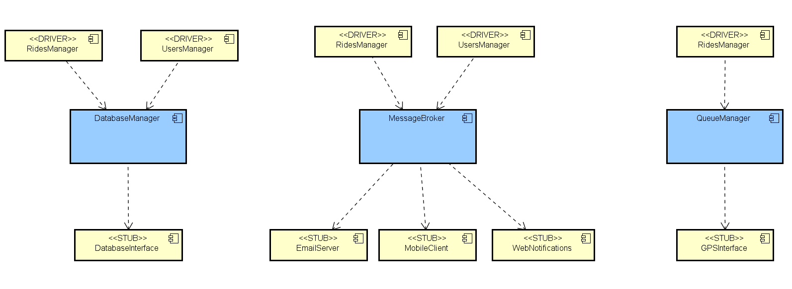
Application Server: Bottom-up testing
Step 1: DatabaseManager, QueueManager and MessageBroker are tested independently.
Next step: User Manager Integration

Slide 39
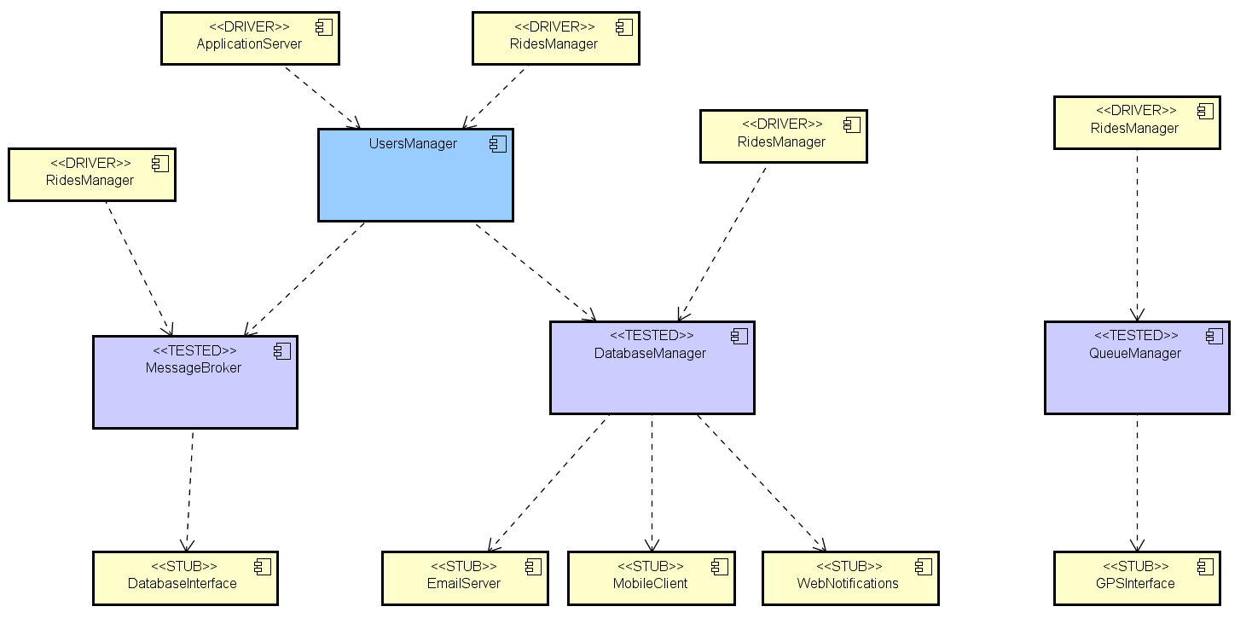
Step 2: User Manager.
Next step: Ride Manager Integration

Slide 40
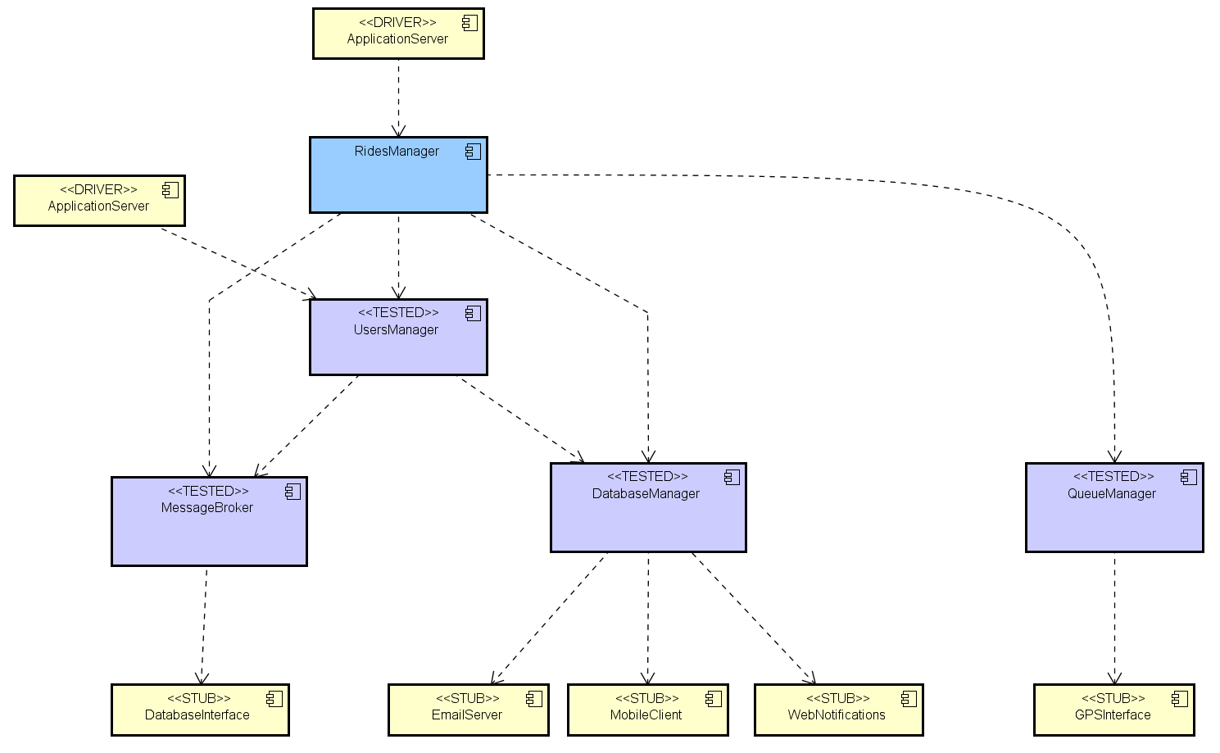
Next step:
Application Server Integration
Step 3: RidesManager.

Slide 41
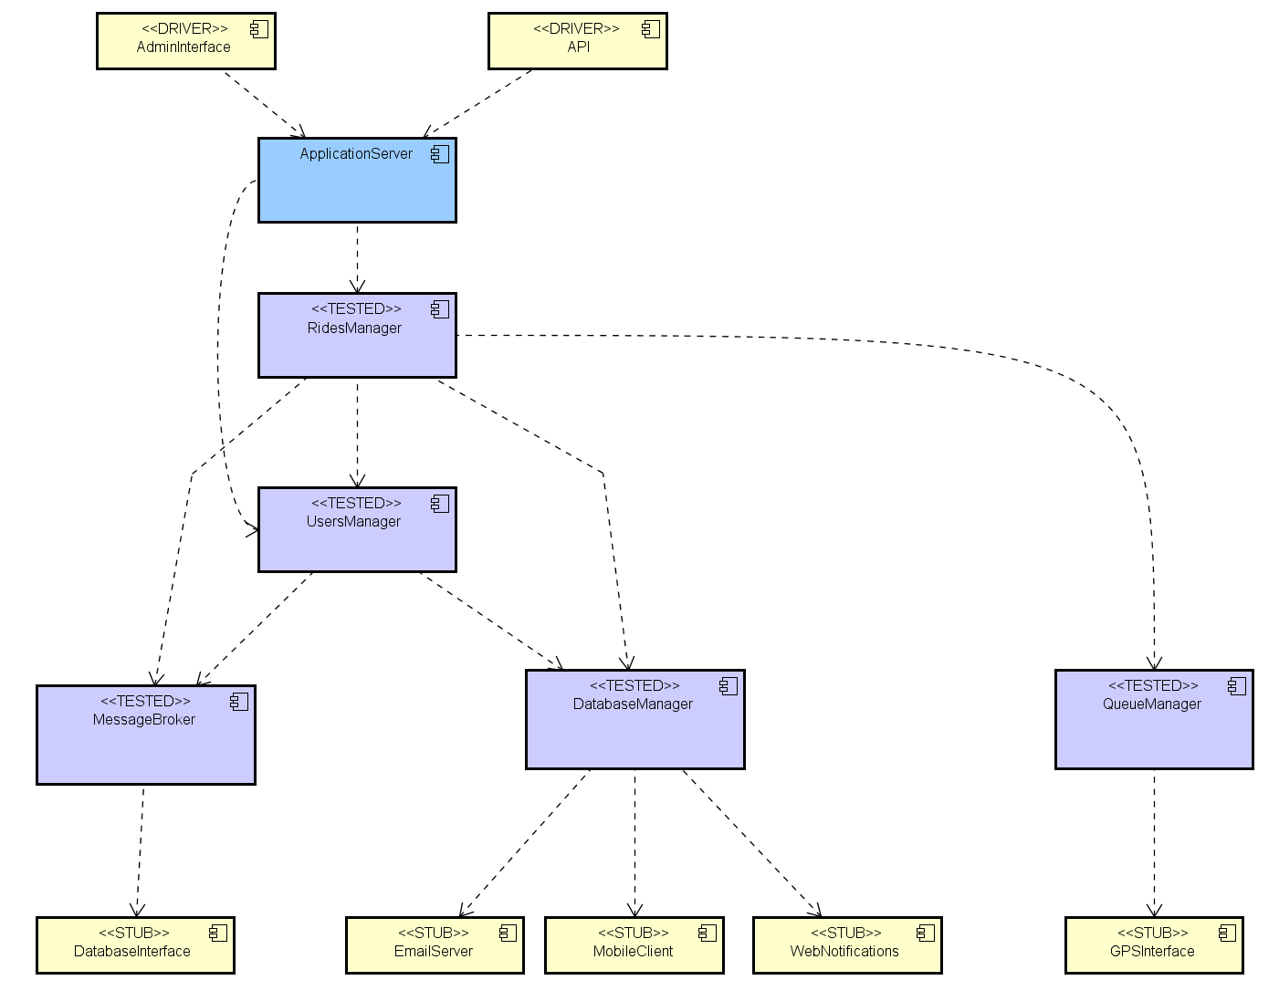
This was the last component!
Step 4: Application Server.

Slide 42
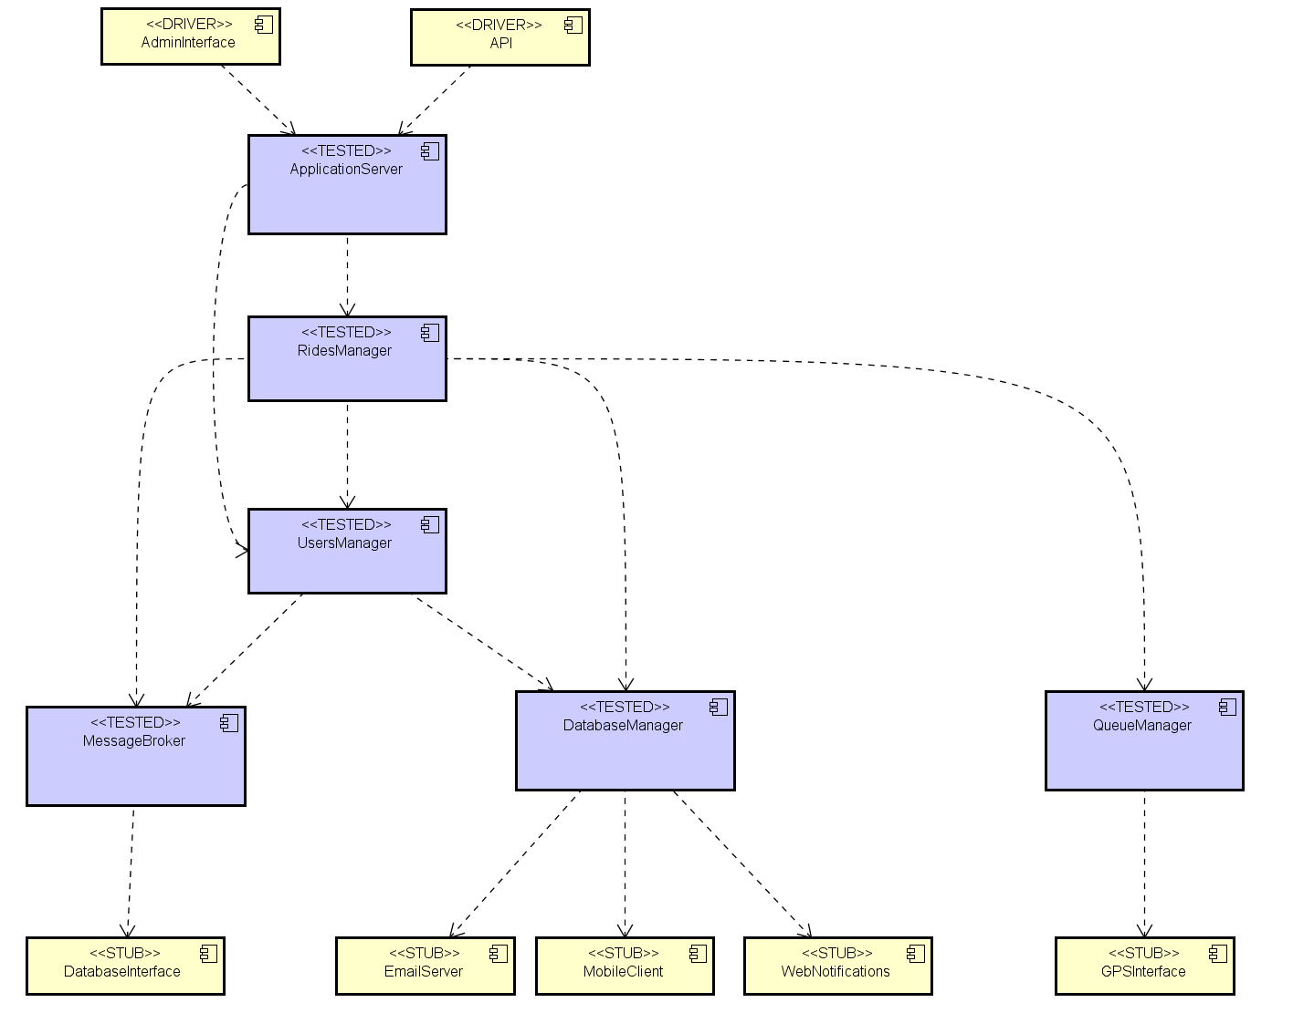
Final result: all components tested.

Slide 43
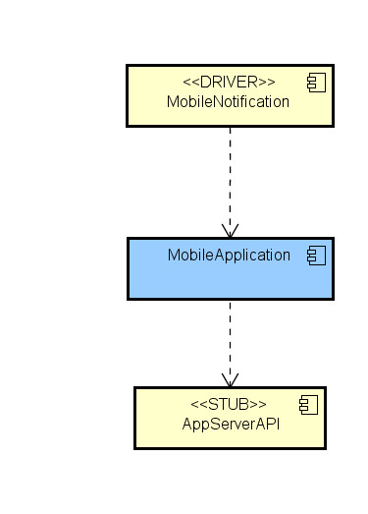
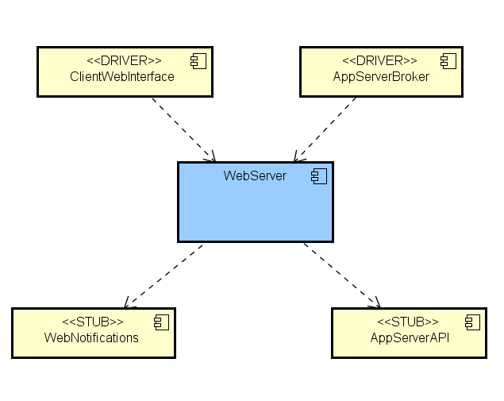
Web Server and Client
Web Server
Client
As said before, Client and Web Server can be tested alone, using only stubs and drivers.

Slide 44
Cost Estimation

Slide 45
Function Points – Measurement parameters
Most of the operations and data files have been considered of simple or medium complexity.
Criteria used:
Internal / External logical files
SIMPLE
Few basic fields
Not related with other data structures
Example: User, Taxi.
MEDIUM
Many fields, possibly critical
Non basic data structures (e.g. graphs)
Example: Rides, City Zones
External input / output / inquiries
SIMPLE
Basic functionalities
Little or no data processing
Example: Login, Logout.
MEDIUM
More data processing or data retrival
May involve multiple type of data
Example: Request a taxi, Visualize the rides history.

Slide 46
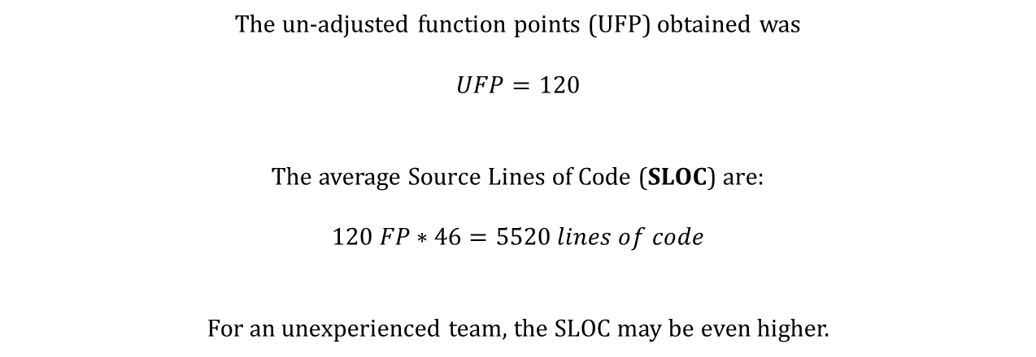
Function Points
The un-adjusted function points (UFP) obtained was
$$UFP=120$$
The average Source Lines of Code (SLOC) are:
$$120 FP∗46=5520 lines of code$$
For an unexperienced team, the SLOC may be even higher.

Slide 47
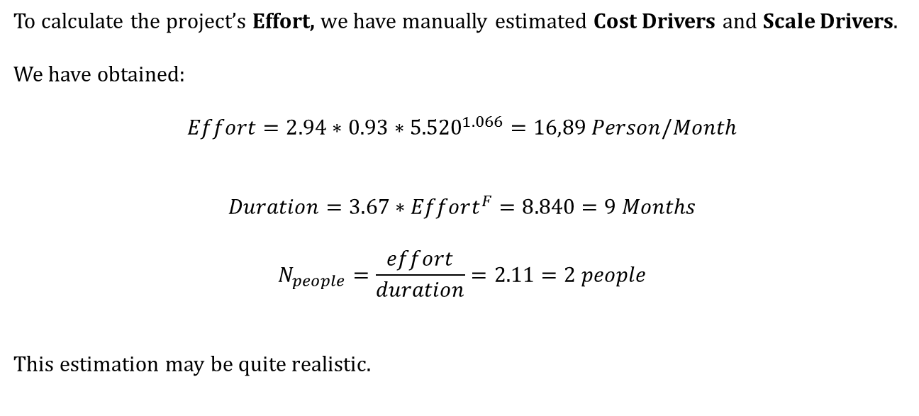
COCOMO II
To calculate the project’s Effort, we have manually estimated Cost Drivers and Scale Drivers.
We have obtained:
$$Effort=2.94∗0.93∗{5.520}^{1.066}=16,89 Person/Month$$
$$Duration=3.67∗Effort^{F}=8.840=9 Months$$
$$N_{people}=\frac{effort}{duration}=2.11=2 people$$
This estimation may be quite realistic.

Slide 48
Thank you!

